Slide 1

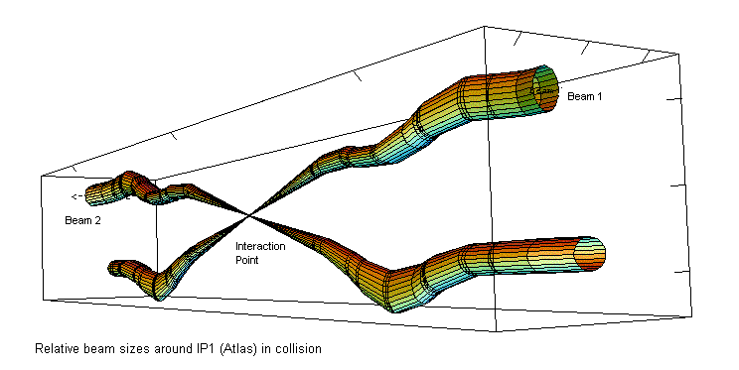
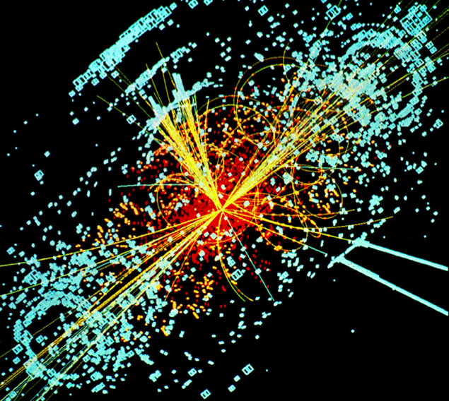
Hadron Colliders
Eric Prebys, FNAL
LHC Interaction Region
Lecture 2

Slide 2
Review and plan
Yesterday:
Basics of transverse motion and strong focusing
Today
Longitudinal motion
“Tricks of the trade”
Colliders and luminosity

Slide 3
Longitudinal Motion
We will generally accelerate particles using structures that generate time-varying electric fields (RF cavities), either in a linear arrangement or located within a circulating ring
In both cases, we want to phase the RF so a nominal arriving particle will see the same accelerating voltage and therefore get the same boost in energy
cavity 0
cavity 1
cavity N
Nominal Energy

Slide 4
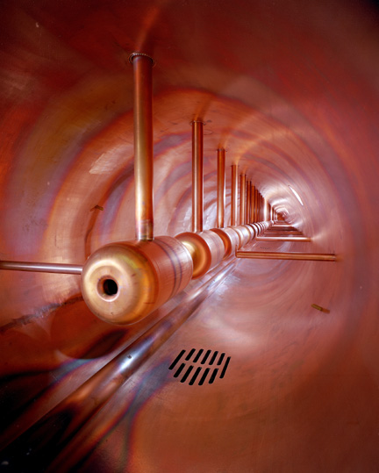
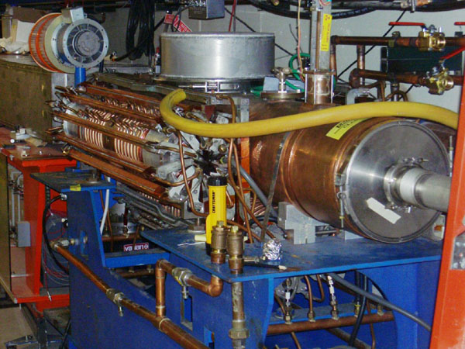
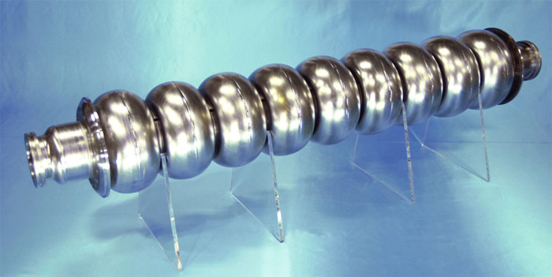
Examples of Accelerating RF Structures
37->53MHz Fermilab Booster cavity
Biased ferrite frequency tuner
Fermilab Drift Tube Linac (200MHz): oscillating field uniform along length
ILC prototype elipical cell “π-cavity” (1.3 GHz): field alternates with each cell

Slide 5
Phase Stability
A particle with a slightly different energy will arrive at a slightly different time, and experience a slightly different acceleration
The relationship between arrival time and difference in energy depends on the details of the machine
Off Energy
Nominal Energy
“slip factor” = dependence of period on momentum

Slide 6
Slip Factor
As cyclotrons became relativistic, high momentum particles take longer to go around.
This led to the initial understanding of phase stability during acceleration.
In general, two effects compete
The behavior of the slip factor depends on the type of machine
Path length
Velocity
Can prove this with a little algebra
“momentum compaction factor” we just talked about
Momentum dependent “slip factor”

Slide 7
Special Cases of Slip Factor
In a linac
In a cyclotron
In a synchrotron, the momentum compaction depends on the lattice, but is usually positive In a normal lattice, for very non-intuitive reasons
negative, asymptotically approaching 0
0 for v<<c, then goes positive. Compensating for this ➔ “synchro-cyclotron”
Starts out negative, then goes positive for
“transition”
electron machines are almost always above transition. Proton machines go through transition

Slide 8
Transition and phase stability
The sign of the slip factor determines the stable region on the RF curve.
Somewhat complicated phase manipulation at transition, which can result in losses, emittance growth, and instability
Easy with digital electronics, but they’ve been doing this since way before digital electronics.
Below γ_{t}: velocity dominates
Above γ_{t} : path length dominates
“bunch”
Particles with lower E arrive earlier and see greater V.
Particles with lower E arrive later and see greater V.
Nominal Energy
Nominal Energy

Slide 9
Synchrotron motion and synchrotron tune
A particle with a slightly different energy will arrive at a slightly different time, and experience a slightly different acceleration
If then particles will stably oscillate around this equilibrium energy with a “synchrotron frequency” and “synchrotron tune”
Off Energy
Nominal Energy

Slide 10
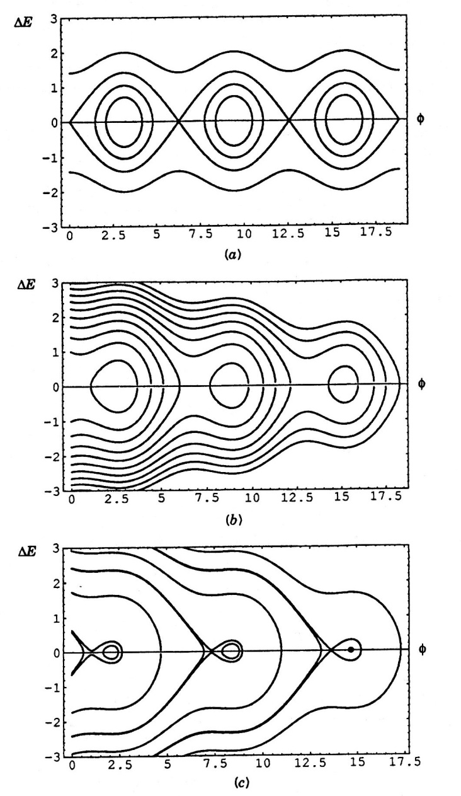
Accelerating phase and longitudinal emittance
The accelerating voltage grows as sinφ_{s}, but the stable bucket area shrinks
Just as in the transverse plane, we can define a phase space, this time in the Δt-ΔE plane
As particles accelerate or accelerating voltage changes
All beam bunched and stable
Area = “longitudinal emittance” (usually in eV-s)
Stable “bucket”

Slide 11
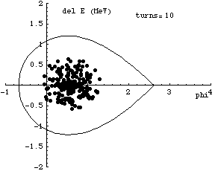

Phase stability at transition
At transition, η=0, so beam would quickly become longitudinally unstable. It’s therefore important to get through transition quickly*
There are also “gamma-t jump” systems which can quickly shift the transition gamma to below the current energy.
*animations courtesy G. Dugan, Cornell

Slide 12
RF Manipulations
Synchrotron (longitudinal) oscillations generally take many revolutions to complete one cycle (ν<<1).
That means that if there are multiple RF cavities around the ring, the orbiting particle will see the vector sum of the cavities.
We will clearly get the maximum energy gain if all phases are the same, so (assuming all voltages are the same)
RF1
RF2
RF3
RF3
φ_{i} is the phase angle at the arrival of the particle at cavity i

Slide 13
Do we always want the maximum acceleration?
There are times when we want to change the amplitude of the RF quickly.
Because cavities represent stored energy, changing their amplitude quickly can be difficult.
Much quicker to change phase
Standard technique is to divide RF cavities into two groups and adjust the relative phase. In the simplest case, we put half the RF cavities into group “A” and half into group “B”. We can adjust the phases of these cavities relative to our nominal synchronous phase as
So
Like “turning RF off”

Slide 14
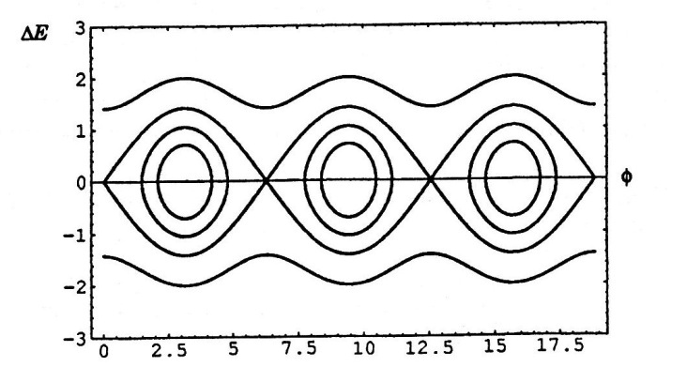
RF capture
We can capture beam by increasing the RF voltage with no accelerating phase
As we accelerate beam, Δt decreases. Recall
So as beam accelerates, bunches get narrower

Slide 15
Bucket to Bucket Transfer
In general, the accelerating gradient of an RF structure is
So when bunches get short enough, it’s advantageous to transfer to a higher frequency. For example, in the Fermilab Linac
200 MHz Linac
800 MHz Linac
Transfer beam to every 4th bucket

Slide 16
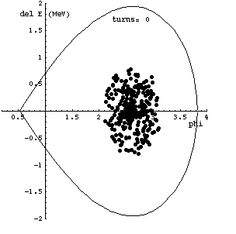
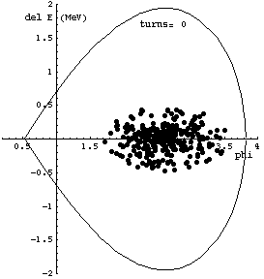
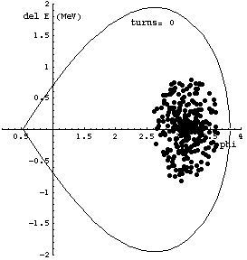



Effect of mismatching
In bucket-to-bucket transfers, it’s very important to match both the shape and the phase of the longitudinal bunch. Failing to do so could result in effectively increasing the emittance.
matched
shape (β_{L}) mismatch
phase mismatch

Slide 17
Bunch Rotation
If we slowly change the RF voltage (or effective voltage by phasing), we can adiabatically change the bunch shape
If we suddenly change the voltage, then the bunch will be mismatched and will rotate in longitudinal phase space

Slide 18
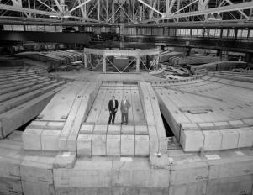
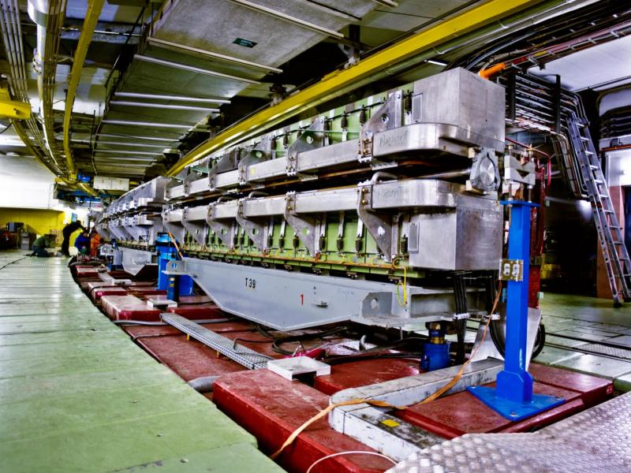
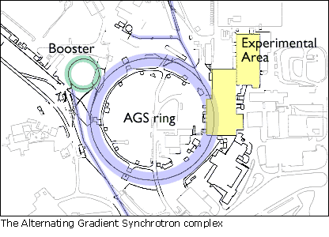
Some Important Early Synchrotrons
Berkeley Bevatron,
1954 (weak focusing)
6.2 GeV protons
Discovered antiproton
CERN Proton Synchrotron (PS)
1959
628 m circumference
28 GeV protons
Still used in LHC injector chain!
CERN Proton Synchrotron (PS)
1960
808 m circumference
33 GeV protons
Discovered charm quark, CP violation, muon neutrino

Slide 19
Digression: tricks of the trade
Early synchrotrons had low energy injection and provided all the acceleration in a single stage.
The energy range of a single synchrotron is limited by
An aperture large enough for the injected beam is unreasonably large at high field.
Hysteresis effects result in excessive nonlinear terms at low energy (very important for colliders)
Typical range 10-20 for colliders, larger for fixed target
Fermilab Main Ring: 8-400 GeV (50x)
Fermilab Tevatron: 150-980 GeV (6.5x)
LHC: 400-7000 GeV (17x)
The highest energy beams require multiple stages of acceleration, with high reliability at each stage
How is this done?

Slide 20
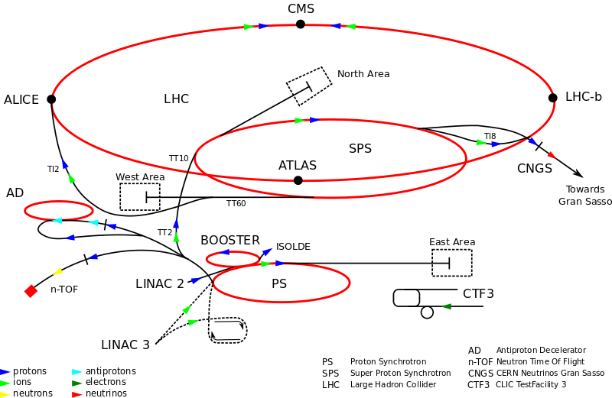
CERN Accelerator Complex
~7 TeV
400 GeV
1.4 GeV
26 GeV
50 MeV

Slide 21
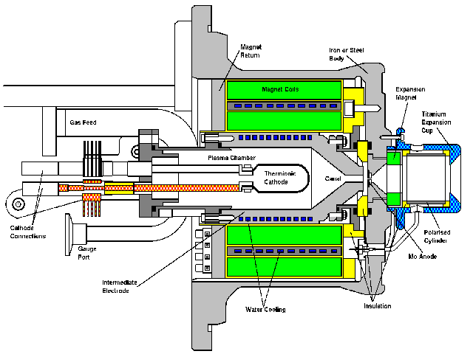
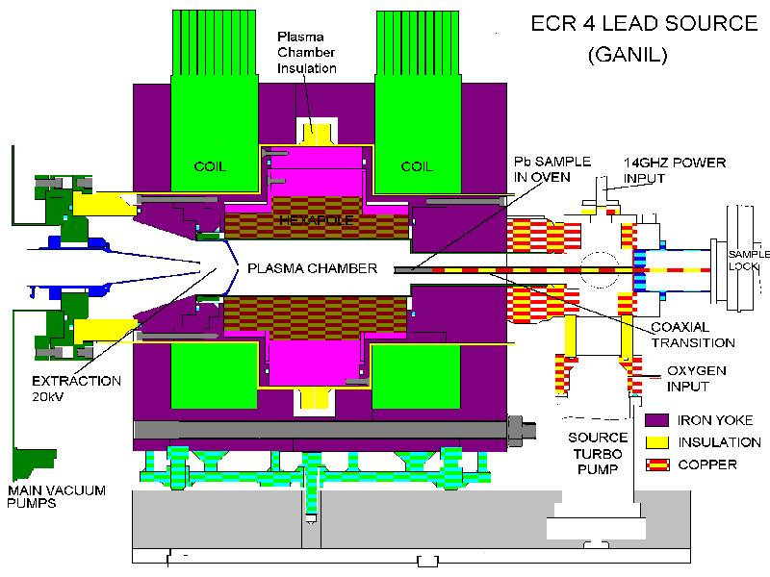
Getting started: Ion sources
CERN proton source
CERN Lead source
FNAL H- source. Mix Cesium with Hydrogen to add electron. (why? we’ll get to that)
Typically 10s of keV and mAs to 10s of mA of current Want to accelerate as fast as possible before space charge blows up the beam!

Slide 22
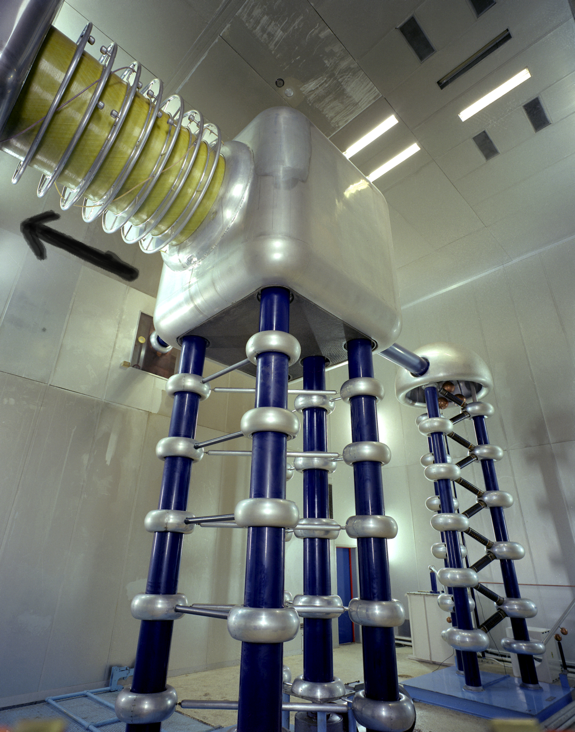
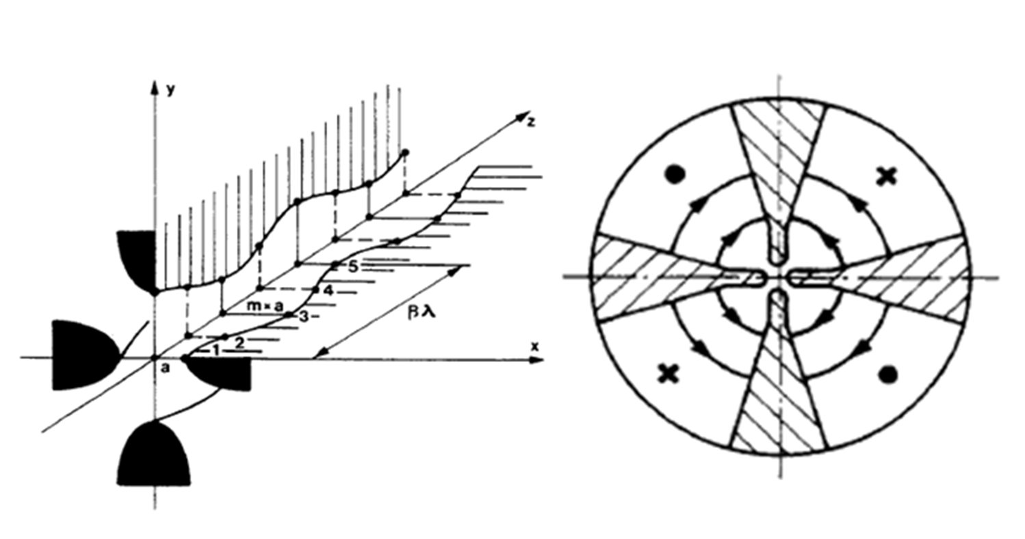
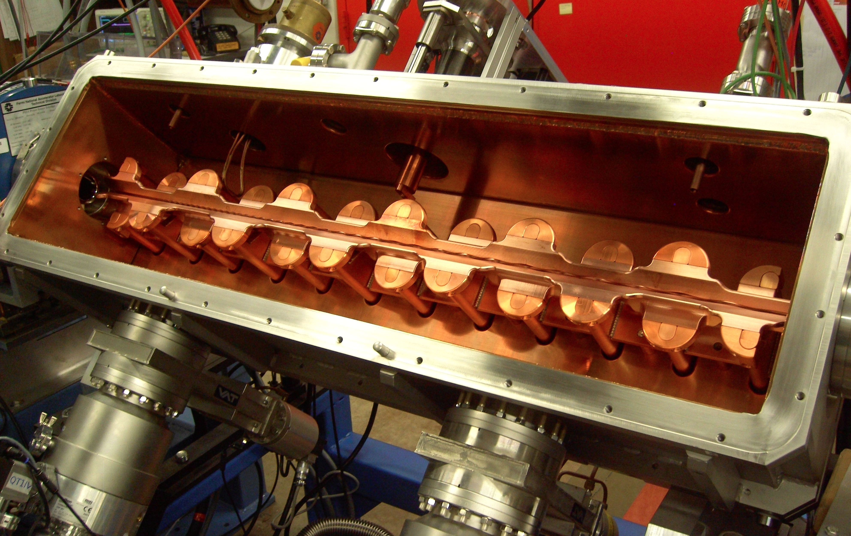
Initial acceleration
Old: Static
New: RF Quadrupole (RFQ)
Static acceleration from Cockcroft-Walton. FNAL = 750 keV
max ~1 MeV
RF structure combines an electric focusing quadrupole with a longitudinal accelerating gradient.

Slide 23
Early stages
The front end of any modern hadron accelerator looks something like this (Fermilab front end)
200 MHz RFQ: 35➔750 keV
Solenoidal focusing for low energy beam
Redundant H⁻ sources: 0-35 keV
Medium Energy Beam Transport (MEBT, pronounced “mebbit”): 750 kEV
Low Energy Beam Transport (LEBT, pronounced “lebbit”): 35 keV

Slide 24
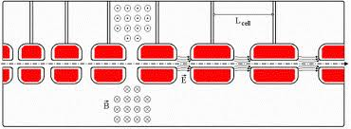
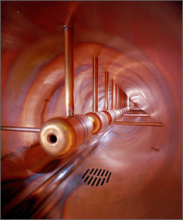
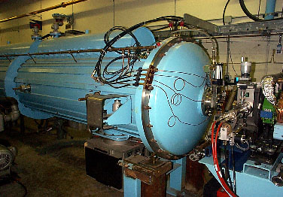
Drift Tube (Alvarez) Cavity
Because the velocity is changing quickly, the first linac is generally a Drift Tube Linac (DTL), which can be beta-matched to the accelerating beam.
Put conducting tubes in a larger pillbox, such that inside the tubes E=0
As energy gets higher, switch to “pi-cavities”, which are more efficient
Bunch of pillboxes
Gap spacing changes as velocity increases
Drift tubes contain quadrupoles to keep beam focused
➔
Fermilab low energy linac
Inside

Slide 25
Linac -> synchrotron injection
Eventually, the linear accelerator must inject into a synchrotron
In order to maximize the intensity in the synchrotron, we can
Increase the linac current as high as possible and inject over one revolution
There are limits to linac current
Inject over multiple (N) revolutions of the synchrotron
Preferred method
Unfortunately, Liouville’s Theorem says we can’t inject one beam on top of another
Electrons can be injected off orbit and will “cool” down to the equilibrium orbit via synchrotron radiation.
Protons can be injected a small, changing angle to “paint” phase space, resulting in increased emittance
Linac emittance
Synchrotron emittance

Slide 26
Ion (or charge exchange) injection
Magnetic chicane pulsed to move beam out during injection
Circulating Beam
Beam at injection
H⁻ beam from LINAC
Stripping foil
Instead of ionizing Hydrogen, and electron is added to create H⁻, which is accelerated in the linac
A pulsed chicane moves the circulating beam out during injection
An injected H⁻ beam is bent in the opposite direction so it lies on top of the circulating beam
The combined beam passes through a foil, which strips the two electrons, leaving a single, more intense proton beam.
Fermilab was converted from proton to H⁻ during the 70’s
CERN still uses proton injection, but is in the process of upgrading (LINAC4 upgrade)

Slide 27
Injection and extraction
We typically would like to extract (or inject) beam by switching a magnetic field on between two bunches (order ~10-100 ns)
Unfortunately, getting the required field in such a short time would result in prohibitively high inductive voltages, so we usually do it in two steps:
fast, weak “kicker”
slower (or DC) extraction magnet with zero field on beam path.

Slide 28
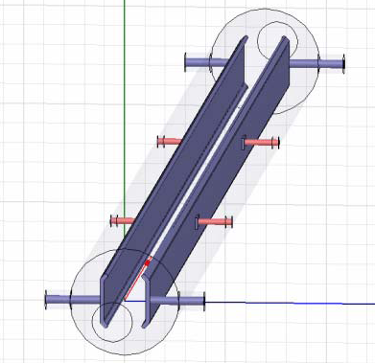
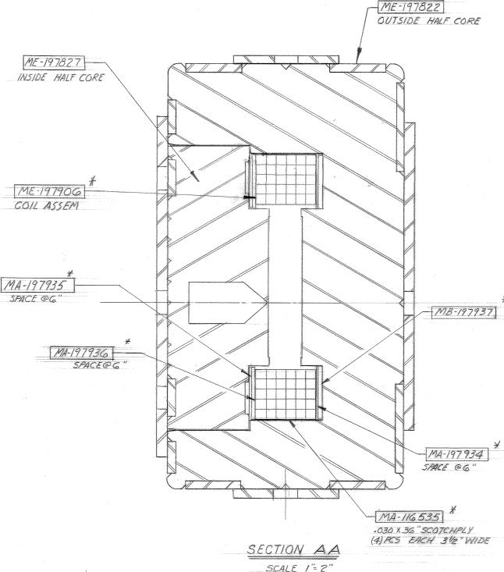
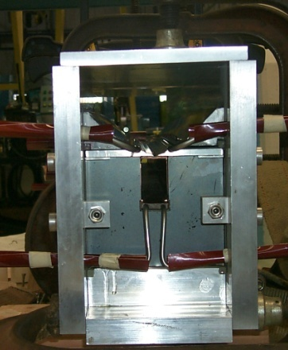
Extraction hardware
“Fast” kicker
usually an impedance matched strip line, with or without ferrites
“Slow” extraction elements
“Lambertson”: usually DC
Septum: pulsed, but slower than the kicker
circulating beam (B=0)
circulating beam (B=0)
B
current “blade”
B
return path

Slide 29
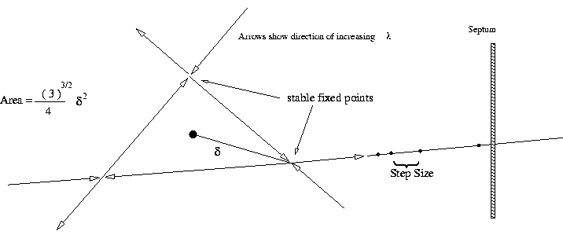
Slow Extraction (not important for colliders)
Sometimes fixed target experiments want beam delivered slowly (difficult)
To do this, we generate a harmonic resonance
Usually sextupoles are used to create a 3rd order resonant instability
Tune the instability so the escaping beam exactly fills the extraction gap between interceptions (3 times around for 3rd order)
Minimum inefficiency ~(septum thickness)/(gap size)
Use electrostatic septum made of a plane of wires. Typical parameters
Septum thickness: .1 mm
Gap: 10 mm
Field: 80 kV
particle flow
E
Particles will flow out of the stable region along lines in phase space into an electrostatic extraction field, which will deflect them into an extraction Lambertson

Slide 30
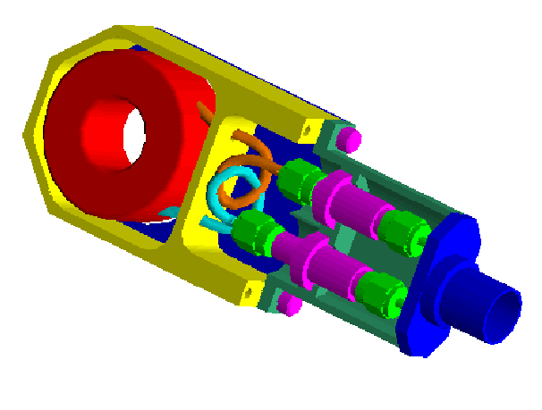
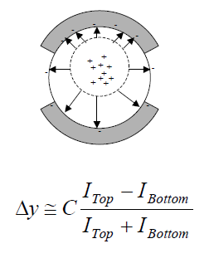
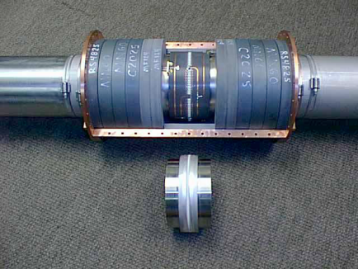
Standard beam instrumentation
Bunch/beam intensity are measured using inductive toriods
Beam position is typically measured with beam position monitors (BPM’s), which measure the induced signal on a opposing pickups
Longitudinal profiles can be measured by introducing a resistor to measure the induced image current on the beam pipe -> Resistive Wall Monitor (RWM)

Slide 31
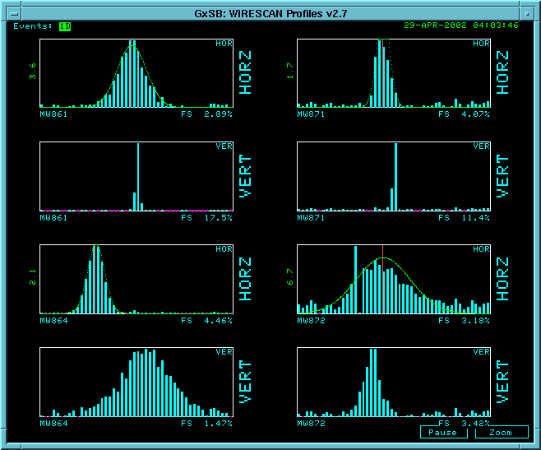
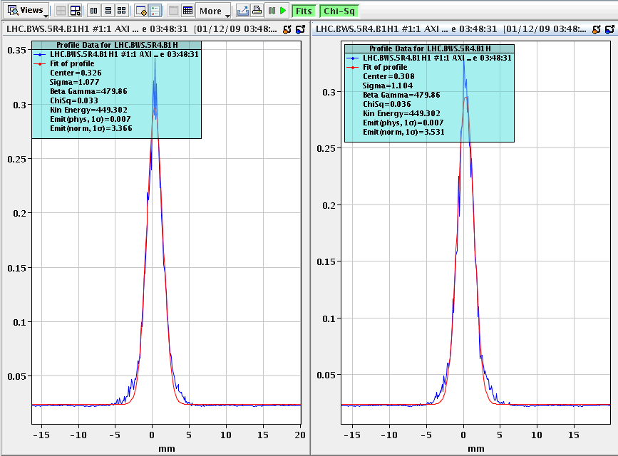
Beam instrumentation (cont’d)
Beam profiles in beam lines can be measured using secondary emission multiwires (MW’s)
Can measure beam profiles in a circulating beam with a “flying wire scanner”, which quickly passes a wire through and measures signal vs time to get profile
Non-destructive measurements include
Ionization profile monitor (IPM): drift electrons or ions generated by beam passing through residual gas
Synchrotron light
Standard in electron machines
Also works in LHC
Beam profiles in MiniBooNE beam line
Flying wire signal in LHC

Slide 32
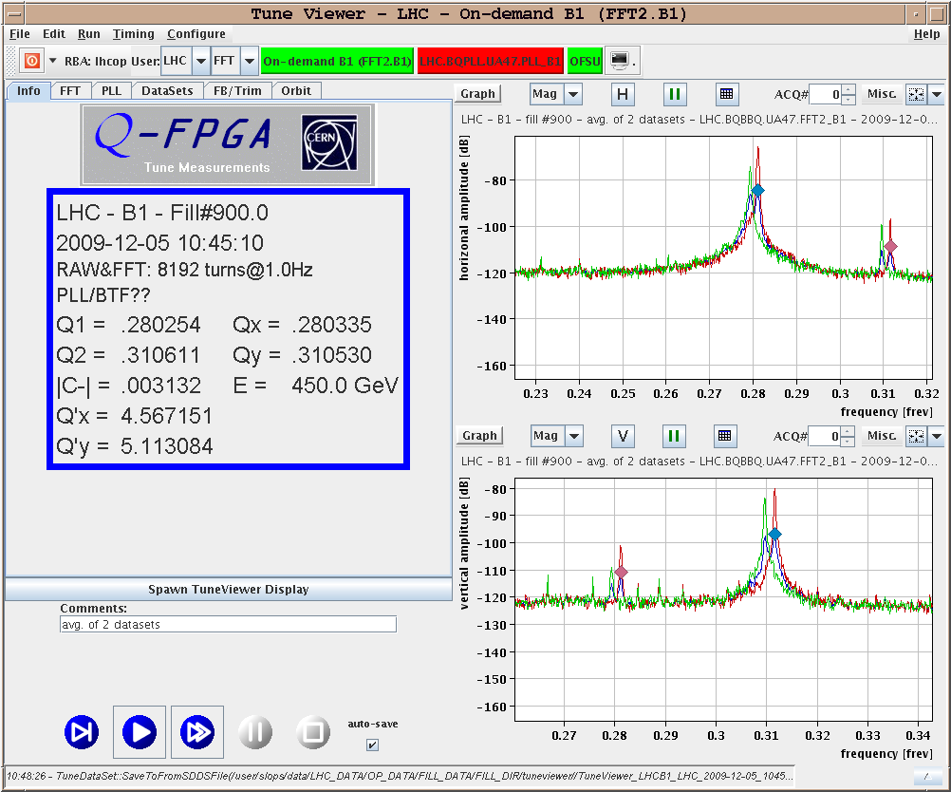
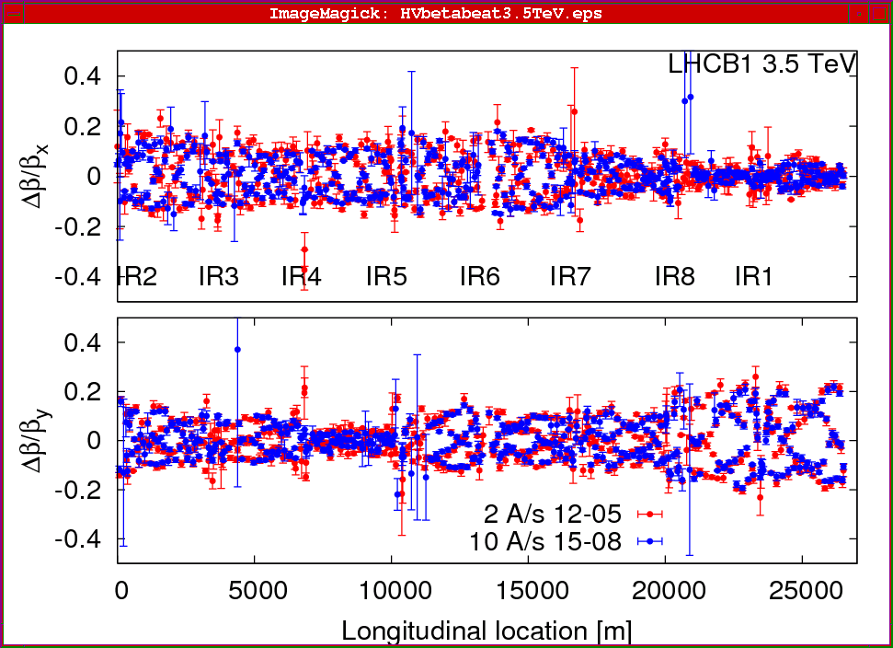
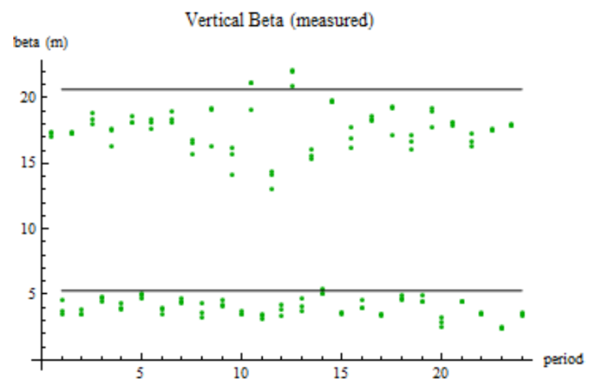
Measuring lattice parameters
The fractional tune is measured by Fourier Transforming signals from the BPM’s
Sometimes need to excite beam with a kicker
Beta functions can be measured by exciting the beam and looking at distortions
Can use kicker or resonant (“AC”) dipole
Can also measure the by functions indirectly by varying a quad and measuring the tune shift

Slide 33
Moving on: The Case for Colliders
If beam hits a stationary proton, the “center of mass” energy is
On the other hand, for colliding beams (of equal mass and energy) it’s
To get the 14 TeV CM design energy of the LHC with a single beam on a fixed target would require that beam to have an energy of 100,000 TeV!
Would require a ring 10 times the diameter of the Earth!!
Getting to the highest energies requires colliding beams

Slide 34
Luminosity
Rate
The relationship of the beam to the rate of observed physics processes is given by the “Luminosity”
Cross-section (“physics”)
“Luminosity”
Standard unit for Luminosity is cm⁻²s⁻¹ Standard unit of cross section is “barn”=10⁻²⁴ cm² Integrated luminosity is usually in barn⁻¹,where
nb⁻¹ = 10⁹ b⁻¹, fb⁻¹=10¹⁵ b⁻¹, etc
For (thin) fixed target:
Target thickness
Example: MiniBooNe primary target:
Incident rate
Target number density

Slide 35
Colliding Beam Luminosity
Circulating beams typically “bunched”
(number of interactions)
Cross-sectional area of beam
Total Luminosity:
Circumference of machine
Number of bunches
crossing rate

Slide 36
Luminosity of Colliding Beams
Particles in a bunch
For equally intense Gaussian beams
Using we have
Collision frequency
Geometrical factor: - crossing angle - hourglass effect
Transverse size (RMS)
prop. to energy
Normalized emittance
Revolution frequency
Betatron function at collision point ➔ want a small β*!
Number of bunches
Particles in bunch
Record e+e- Luminosity (KEK-B): 2.11x10³⁴ cm⁻²s⁻¹ Record p-pBar Luminosity (Tevatron): 4.06x10³² cm⁻²s⁻¹ Record Hadronic Luminosity (LHC): 7.0x10³³ cm⁻²s⁻¹ LHC Design Luminosity: 1.00x10³⁴ cm⁻²s⁻¹

Slide 37
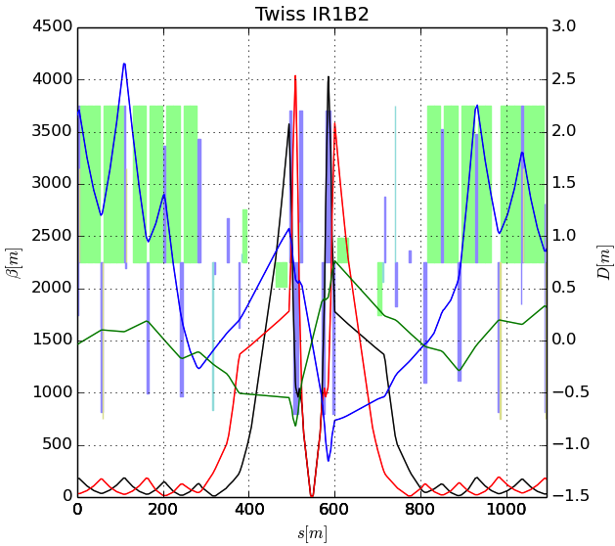
Limits to β*
β
s
➔ small β* means large β (aperture) at focusing triplet

Slide 38
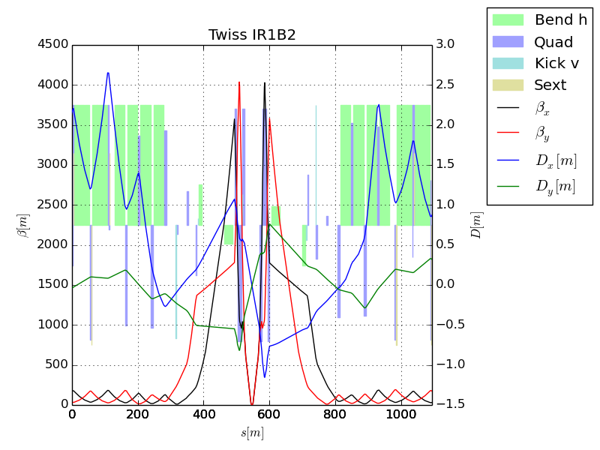
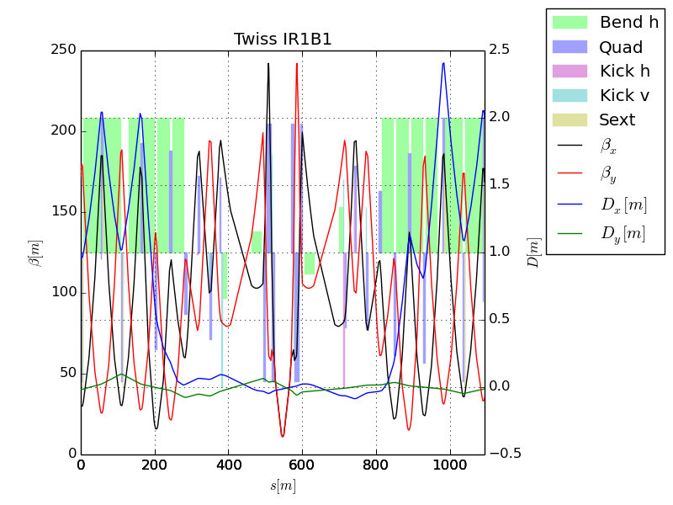
The “squeeze”?
In general, synchrotrons scale all magnetic fields with the momentum, so the optics remain constant – with one exception.
Recall that because of adiabatic damping, beam gets smaller as it accelerates.
This means all apertures must be large enough to accommodate the injected beam.
This a problem for the large β values in the final focus triplets
For this reason, injection optics have a larger value of β*, and therefor a smaller value of β in the focusing triplets.
After acceleration, beam is “squeezed” to a smaller β* for collision
factor of ~4 for LHC

Slide 39
Beam Parameters: LHC
Parameter | Symbol | Equation | Injection | Collision
proton mass | m [GeV/c²] |  | 0.93827
kinetic energy | K [GeV] |  | 400 | 7000
total energy | E [GeV] |  | 400.93827 | 7000.93827
momentum | p [GeV/c] |  | 400.9371721 | 7000.937937
rel. beta | β |  | 0.999997262 | 0.999999991
rel. gamma | γ |  | 427.3165187 | 7461.539077
beta-gamma | βγ |  | 427.3153486 | 7461.53901
rigidity | (Bρ) [T-m] |  | 1337.8 | 23359.8
emittance |  |  | 2.75x10⁻⁶ | 2.75x10⁻⁶
typical beta |  |  | ~100
typical size |  |  | .8 | .2
collision beta |  |  | 11 | .6
collision size |  |  | .266 | .015
max. beta |  |  | 240 | 4000
max size |  |  | 1.3 | 1.3
Squeeze keeps this the same

Slide 40
Luminosity Lifetime
If we keep all other loss mechanisms minimal, the useful life of colliding beams is determined by the “burn rate”, based on the total cross section
Not exponential!
Luminosity lifetime (not constant)
Normally talk about the initial luminosity lifetime

Slide 41
Beam-beam Interaction
If two oppositely charged bunches pass through each other…
Both E and B fields are attractive to the particles in the other bunch
If two bunches with the same sign pass through each other…
Both E and B fields are repulsive to the particles in the other bunch
Forces linear near core
In either case, the forces add. This looks like a little quadrupole in each plane, causing the tune to spread out.

Slide 42
Luminosity and Tuneshift
The total tuneshift will ultimately limit the performance of any collider, by driving the beam onto an unstable resonance. Values of on the order ~.02 are typically the limit. However, we have the somewhat surprising result that the “beam-beam parameter” (scale of spread)
does not depend on β*, but only on
For a collider, we have
We assume we will run the collider at the “tuneshift limit”, in which case we can increase luminosity by
Making β* as small as possible
Increasing N_{b} and ε proportionally.
“classical radius”
bunch size
emittance

Slide 43
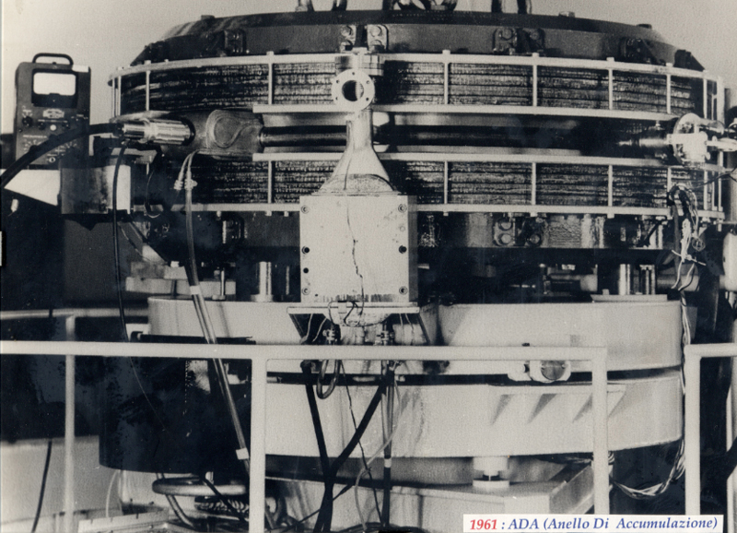
First e⁺e⁻ Collider
ADA (Anello Di Accumulazione) at INFN, Frascati, Italy (1961)
250 MeV e⁺ x 250 MeV e⁻
L~10²⁵ cm⁻²s⁻¹
It’s easier to collide e+e-, because synchrotron radiation naturally “cools” the beam to smaller size.

Slide 44
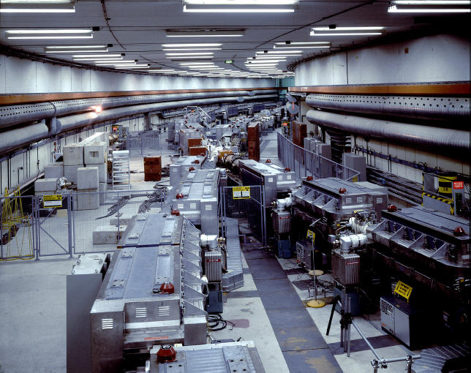
History: CERN Intersecting Storage Rings (ISR)
First hadron collider (p-p)
Highest CM Energy for 10 years
Until SppS
Reached it’s design luminosity within the first year.
Increased it by a factor of 28 over the next 10 years
Its peak luminosity in 1982 was 140x10³⁰ cm⁻²s⁻¹
a record that was not broken for 23 years!!

Slide 45
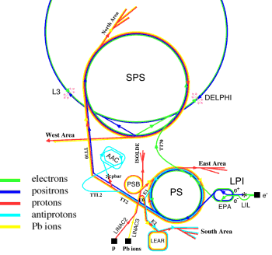
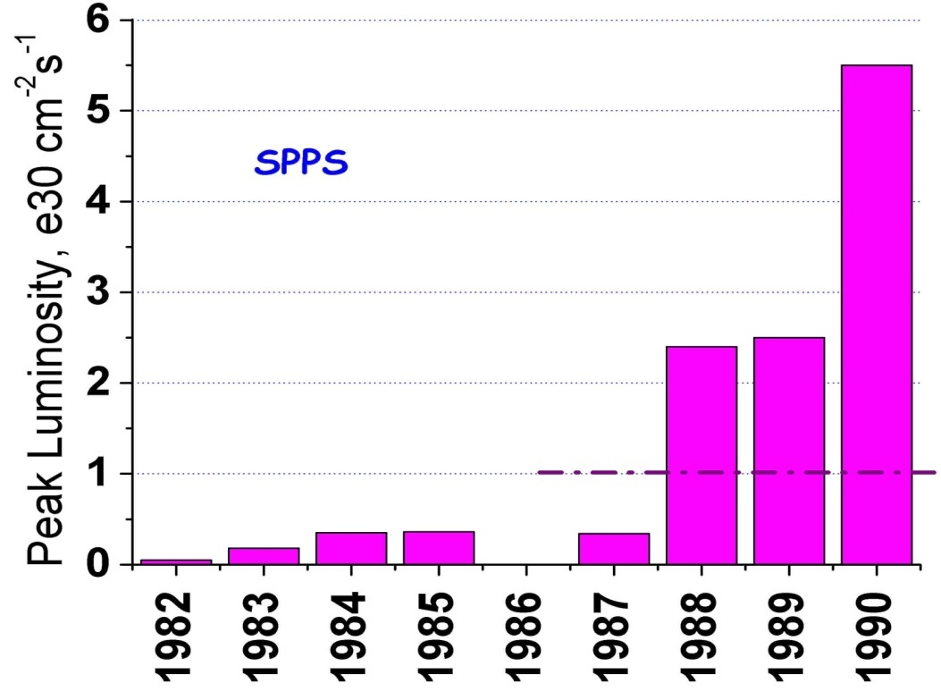
SppS: First proton-antiproton Collider
Protons from the SPS were used to produce antiprotons, which were collected
These were injected in the opposite direction and accelerated
First collisions in 1981
Discovery of W and Z in 1983
Nobel Prize for Rubbia and Van der Meer
Energy initially 270+270 GeV
Raised to 315+315 GeV
Limited by power loss in magnets!
Peak luminosity: 5.5x10³⁰cm⁻²s⁻¹
~.2% of current LHC
design

Slide 46
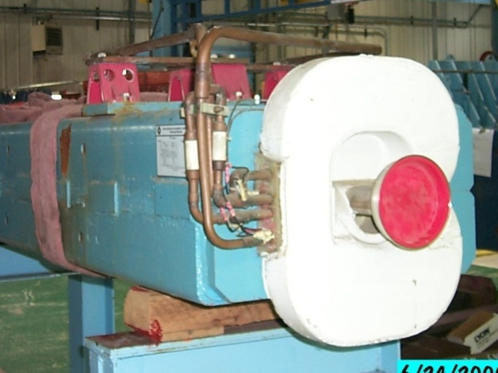
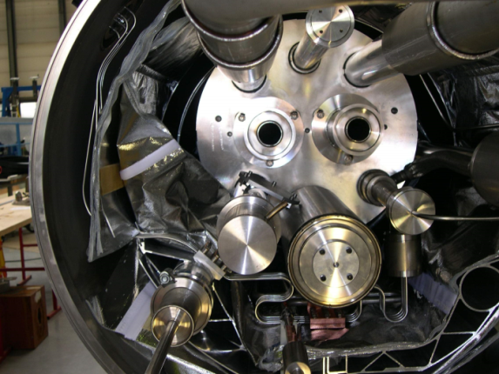
Superconductivity: Enabling Technology
The maximum SppS energy was limited by the maximum power loss that the conventional magnets could support in DC operation
P = I²R proportional to B²
Maximum practical DC field in conventional magnets ~1T
LHC made out of such magnets would be roughly the size of Rhode Island!
Highest energy colliders only possible using superconducting magnets
Must take the bad with the good
Conventional magnets are Superconducting magnets are simple and naturally dissipate complex and represent a great energy as they operate deal of stored energy which must be handled if something goes wrong

Slide 47
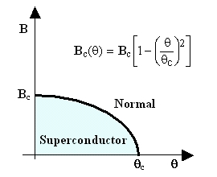
When is a superconductor not a superconductor?
Superconductor can change phase back to normal conductor by crossing the “critical surface”
When this happens, the conductor heats quickly, causing the surrounding conductor to go normal and dumping lots of heat into the liquid Helium➔“quench
all of the energy stored in the magnet must be dissipated in some way
Dealing with quenches is the single biggest issue for any superconducting synchrotron!
Can push the B field (current) too high
Can increase the temp, through heat leaks, deposited energy or mechanical deformation
T_{c}

Slide 48

Quench Example: MRI Magnet*
*pulled off the web. We recover our Helium.

Slide 49
Magnet “training”
As new superconducting magnets are ramped, electromechanical forces on the conductors can cause small motions.
The resulting frictional heating can result in a quench
Generally, this “seats” the conductor better, and subsequent quenches occur at a higher current.
This process is knows as “training”

Slide 50
Milestones on the Road to a Superconducting Collider
1911 – superconductivity discovered by Heike Kamerlingh Onnes
1957 – superconductivity explained by Bardeen, Cooper, and Schrieffer
1972 Nobel Prize (the second for Bardeen!)
1962 – First commercially available superconducting wire
NbTi, the “industry standard” since
1978 – Construction began on ISABELLE, first superconducting collider (200 GeV+200 GeV) at Brookhaven.
1983, project cancelled due to design problems, budget overruns, and competition from…

Slide 51
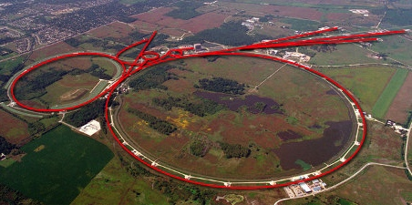
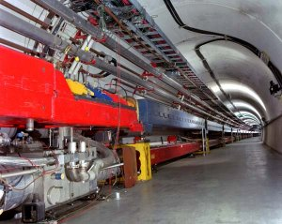
Tevatron: First Superconducting Synchrotron
1968 – Fermilab Construction Begins
1972 – Beam in Main Ring
(normal magnets)
Plans soon began for a superconducting collider to share the ring.
Dubbed “Saver Doubler” (later “Tevatron”)
1985 – First proton-antiproton collisions in Tevatron
Most powerful accelerator in the world for the next quarter century
1995 – Top quark discovery
Reached L=4.06x10³² cm⁻²s⁻¹
Breaking ISR p-p record
2011 – Tevatron shut down after successful LHC startup
Main Ring
Tevatron

